Slide 1
Automated Attendance System
Using Machine Learning

Slide 2
Timeline:
Week 1
Week 2
Week 3
Week 4
Face and Eye detection using openCV
Use of face_recognition library using python
Create database using MySQL with proper datatypes
Store the face encodings in database
Week 5
Week 6
Week 7
Design front end and interactive dashboard for users
Build functionality to take and store attendance
Debugging and new features

Slide 3
First two weeks!
Database
Basic front end
*Database
*Face encodings
*User and Admin login
*Interactive dashboard
Week 01
Week 02
Created database and stored face encodings as BLOB files
Created interactive front end for users

Slide 4
Second two weeks!
Functionality
Front end
*Attendance
*Storing into database
*Faculty dashboard
*New Admin dashboard
Week 03
Week 04
Created functionality to take attendance from the interface
New front end for faculty and admin

Slide 5
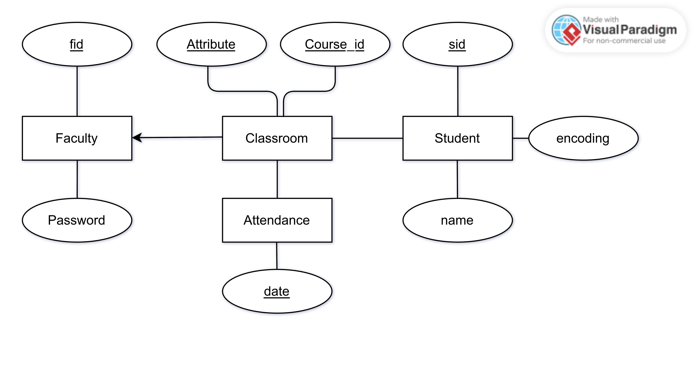
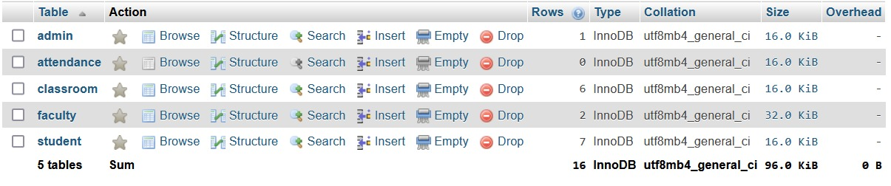
Database

Slide 6
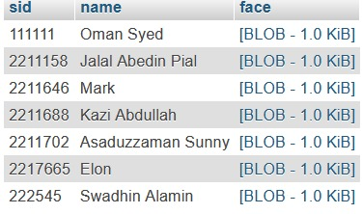
Storing Face Encoding

Slide 7
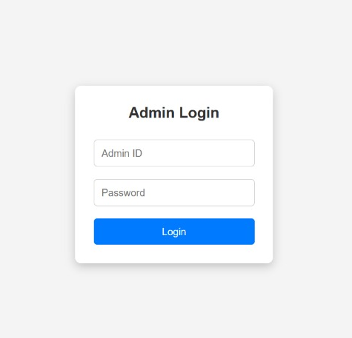
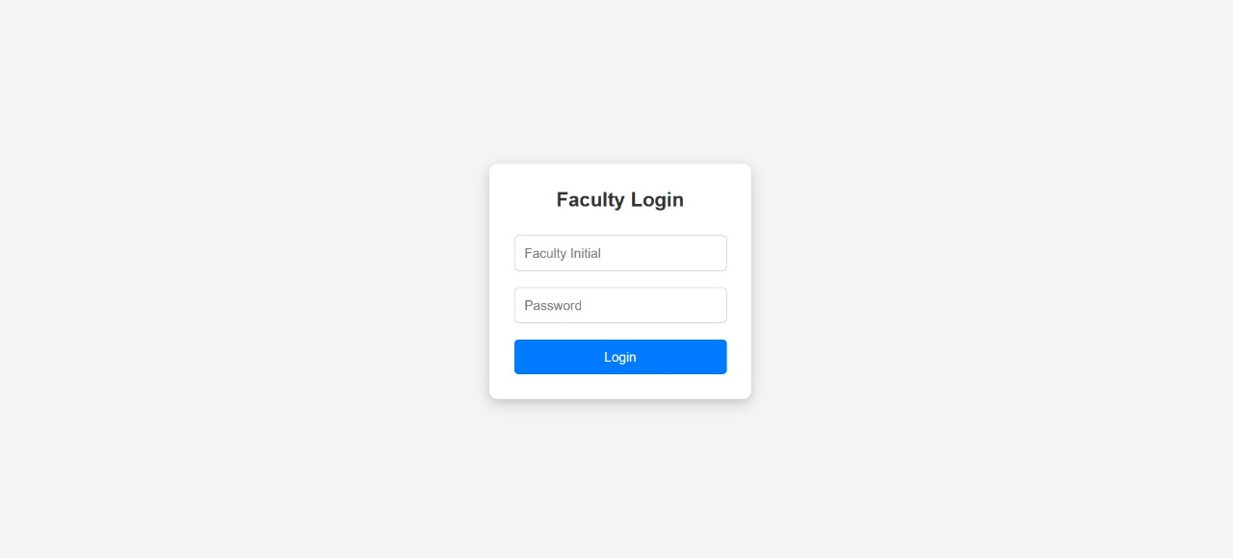
Intial Front End

Slide 8
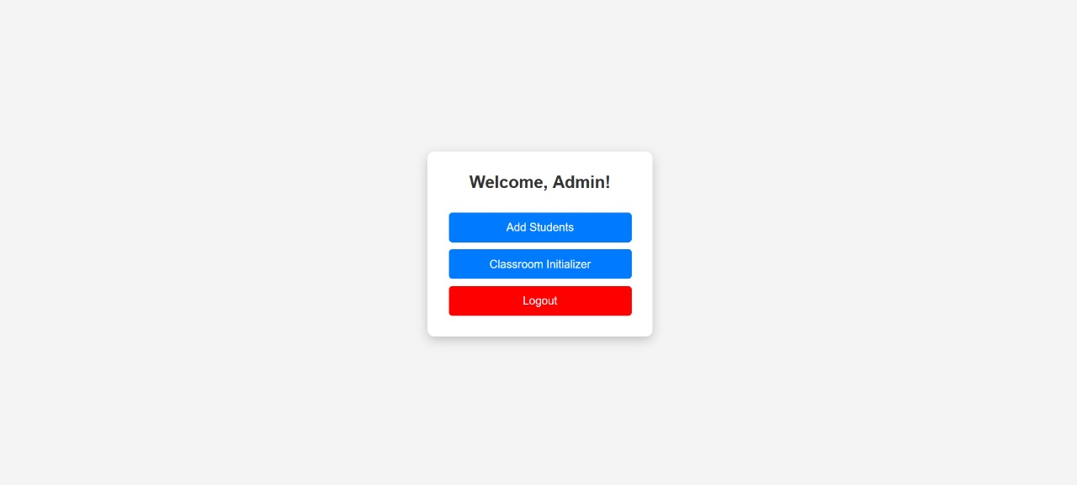
Intial Admin Dashboard

Slide 9

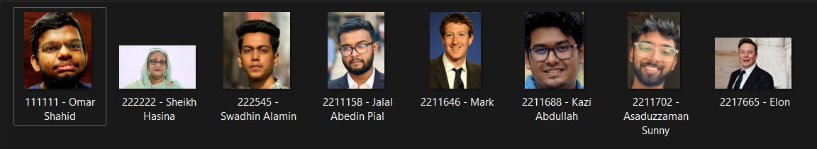
Add Students

Slide 10
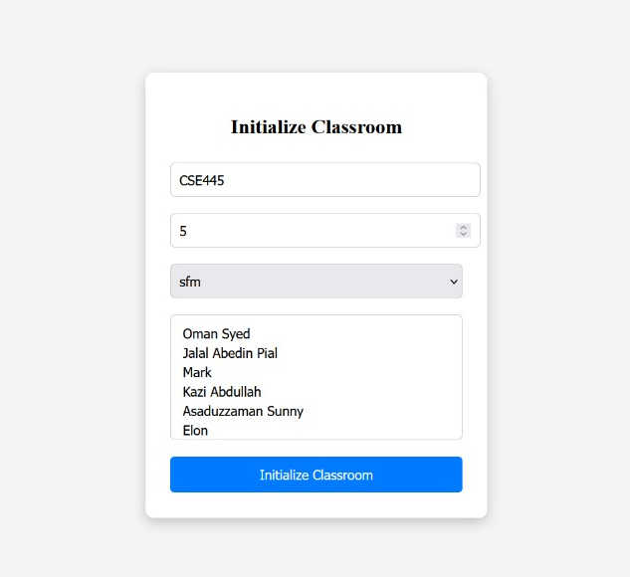
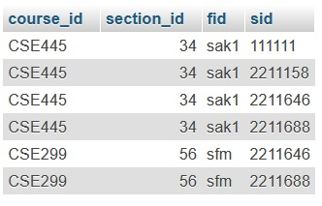
Initialize Classroom

Slide 11
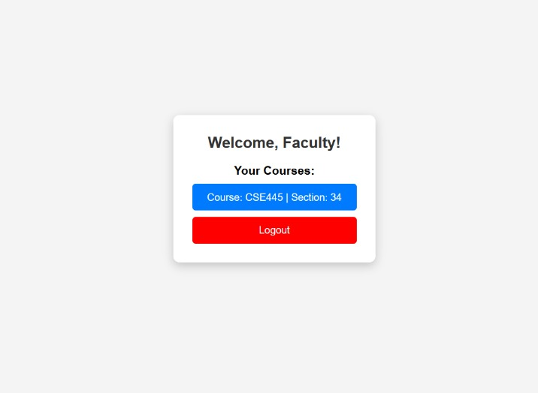
Initial Faculty Dashboard

Slide 12
Faculty Dashboard Plan
Select Any Course
he/she teaching
Run python script to take attendance
Attendance History
Manual Attendance

Slide 13
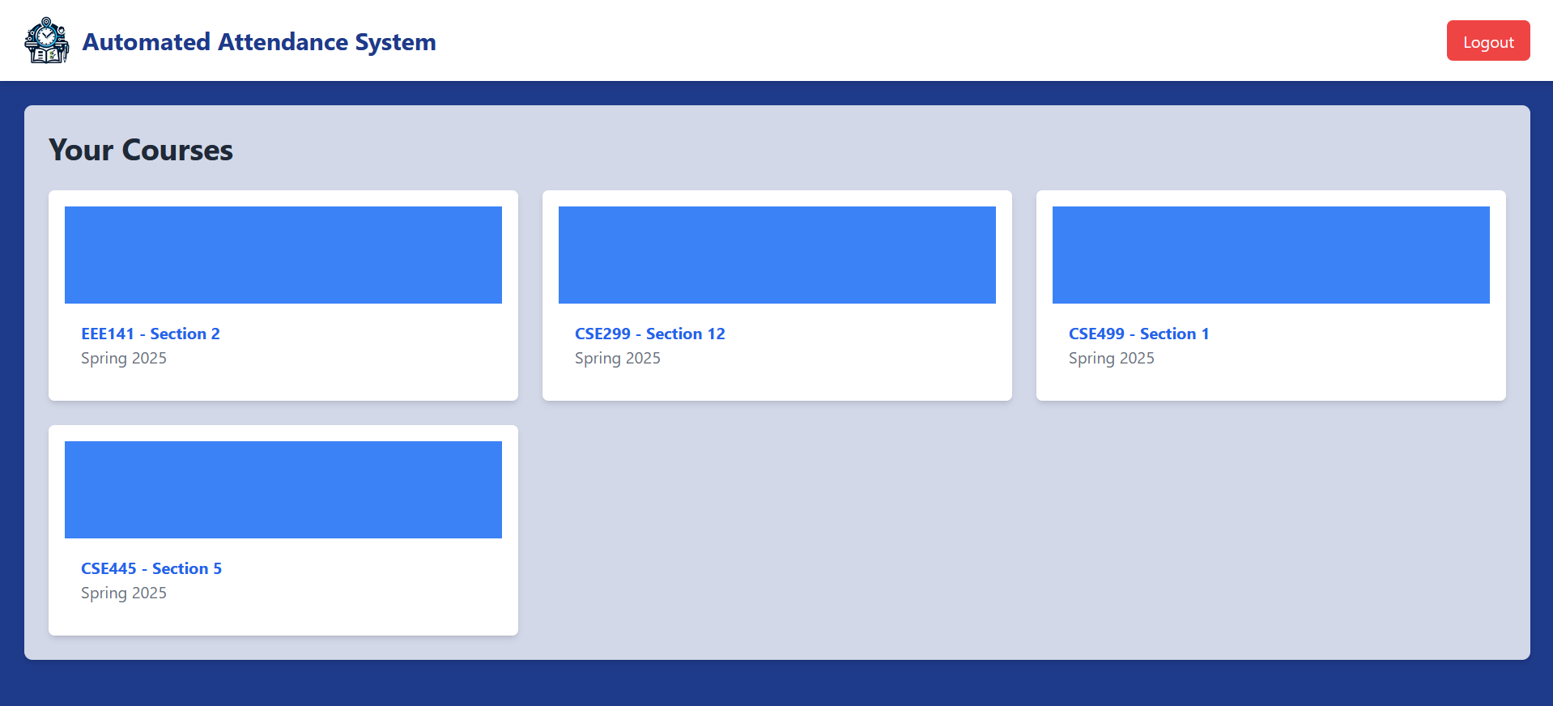
New Faculty Dashboard

Slide 14
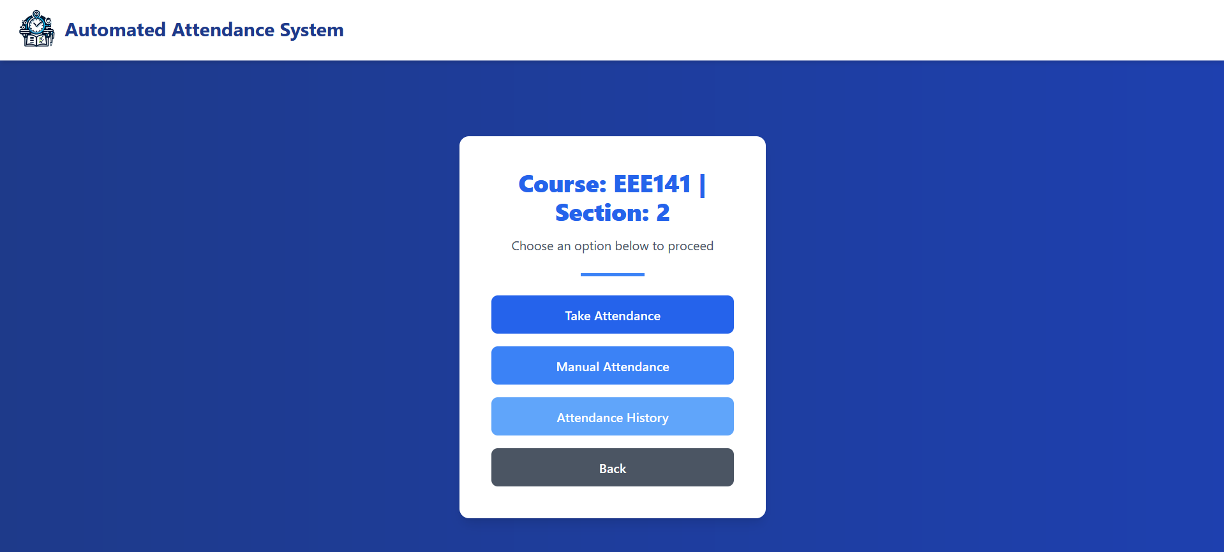
Course Options

Slide 15
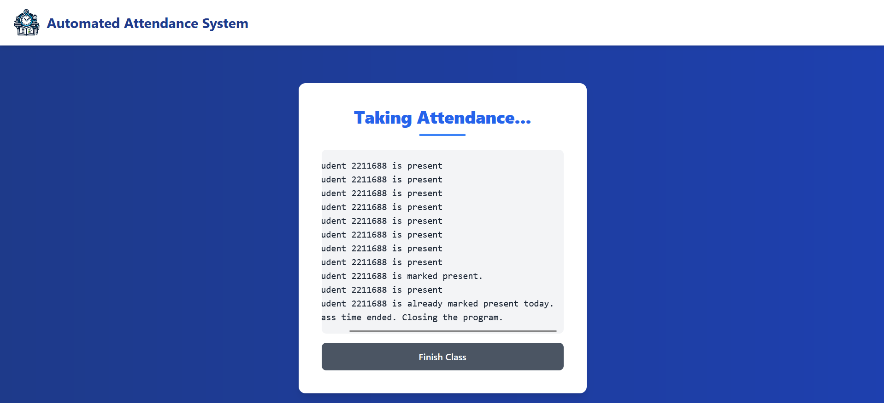
Attendance Functionality

Slide 16
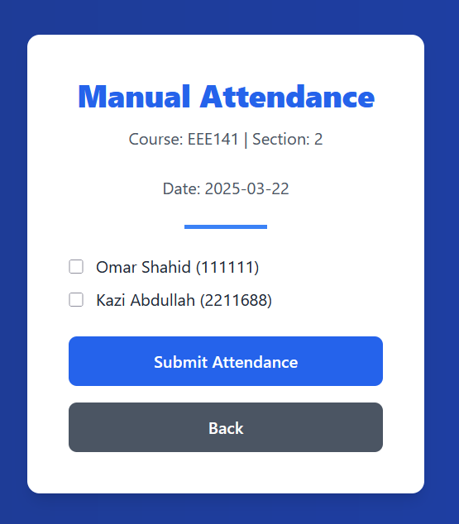
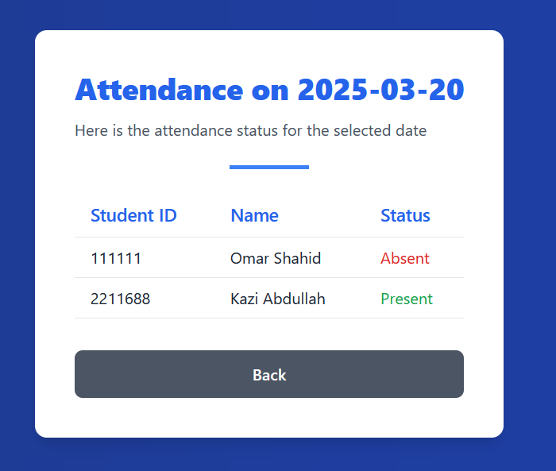
Manual Attendance and History

Slide 17
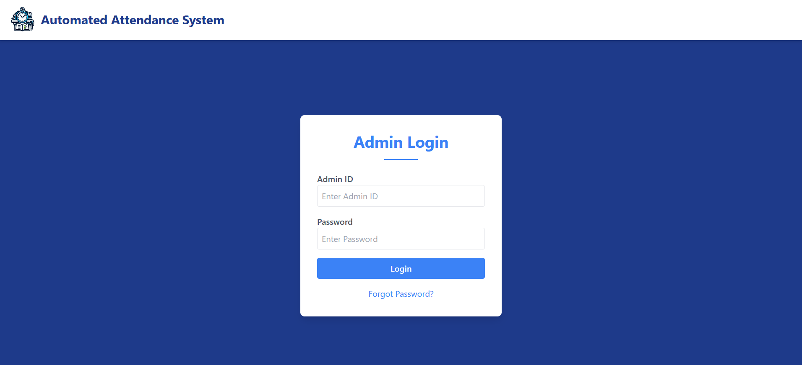
New Login Page

Slide 18
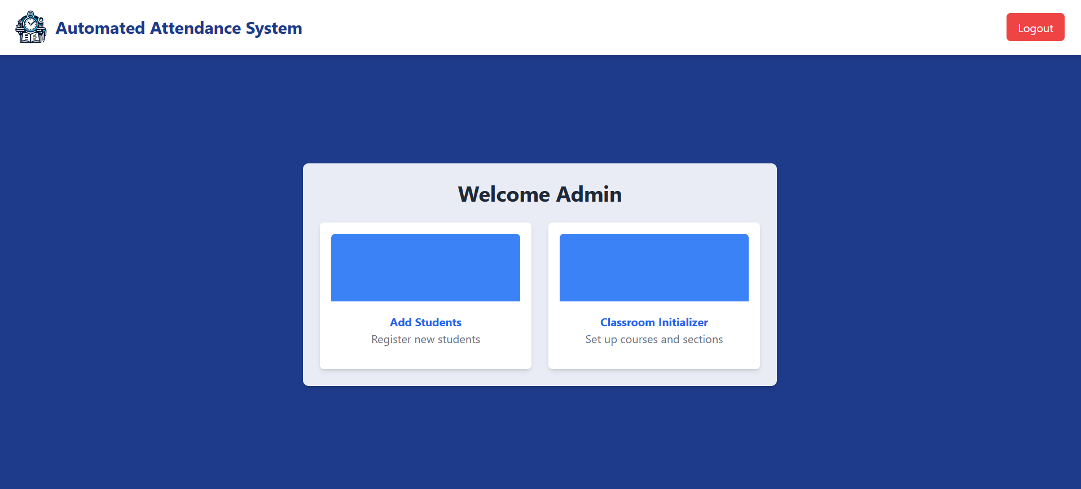
New Admin Dashboard

Slide 19
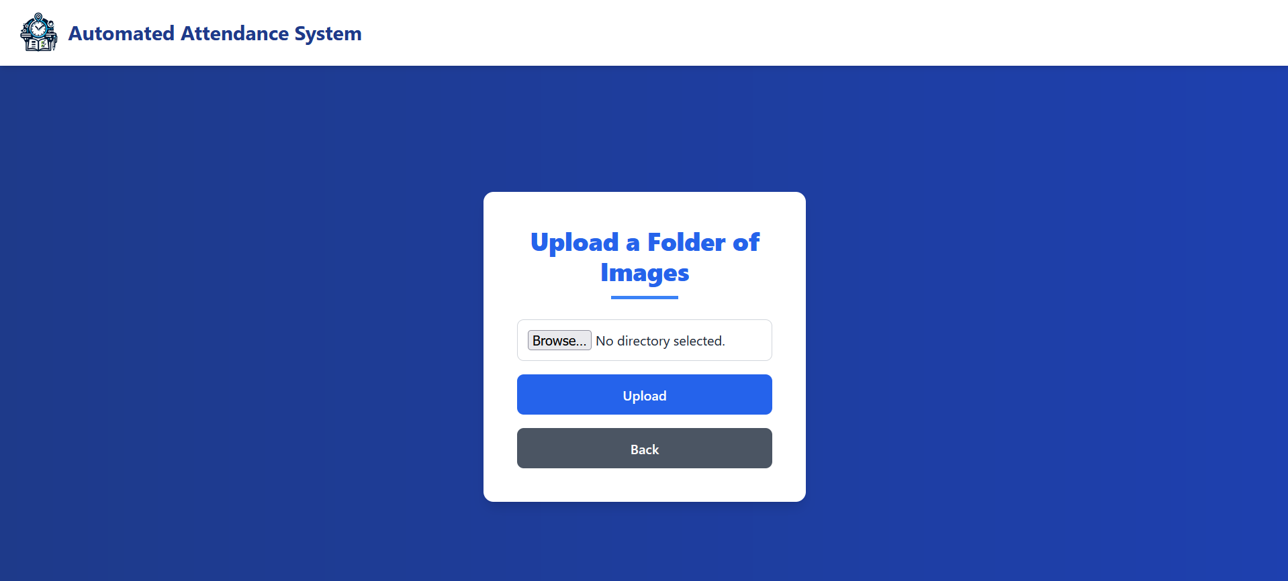
Add Students

Slide 20
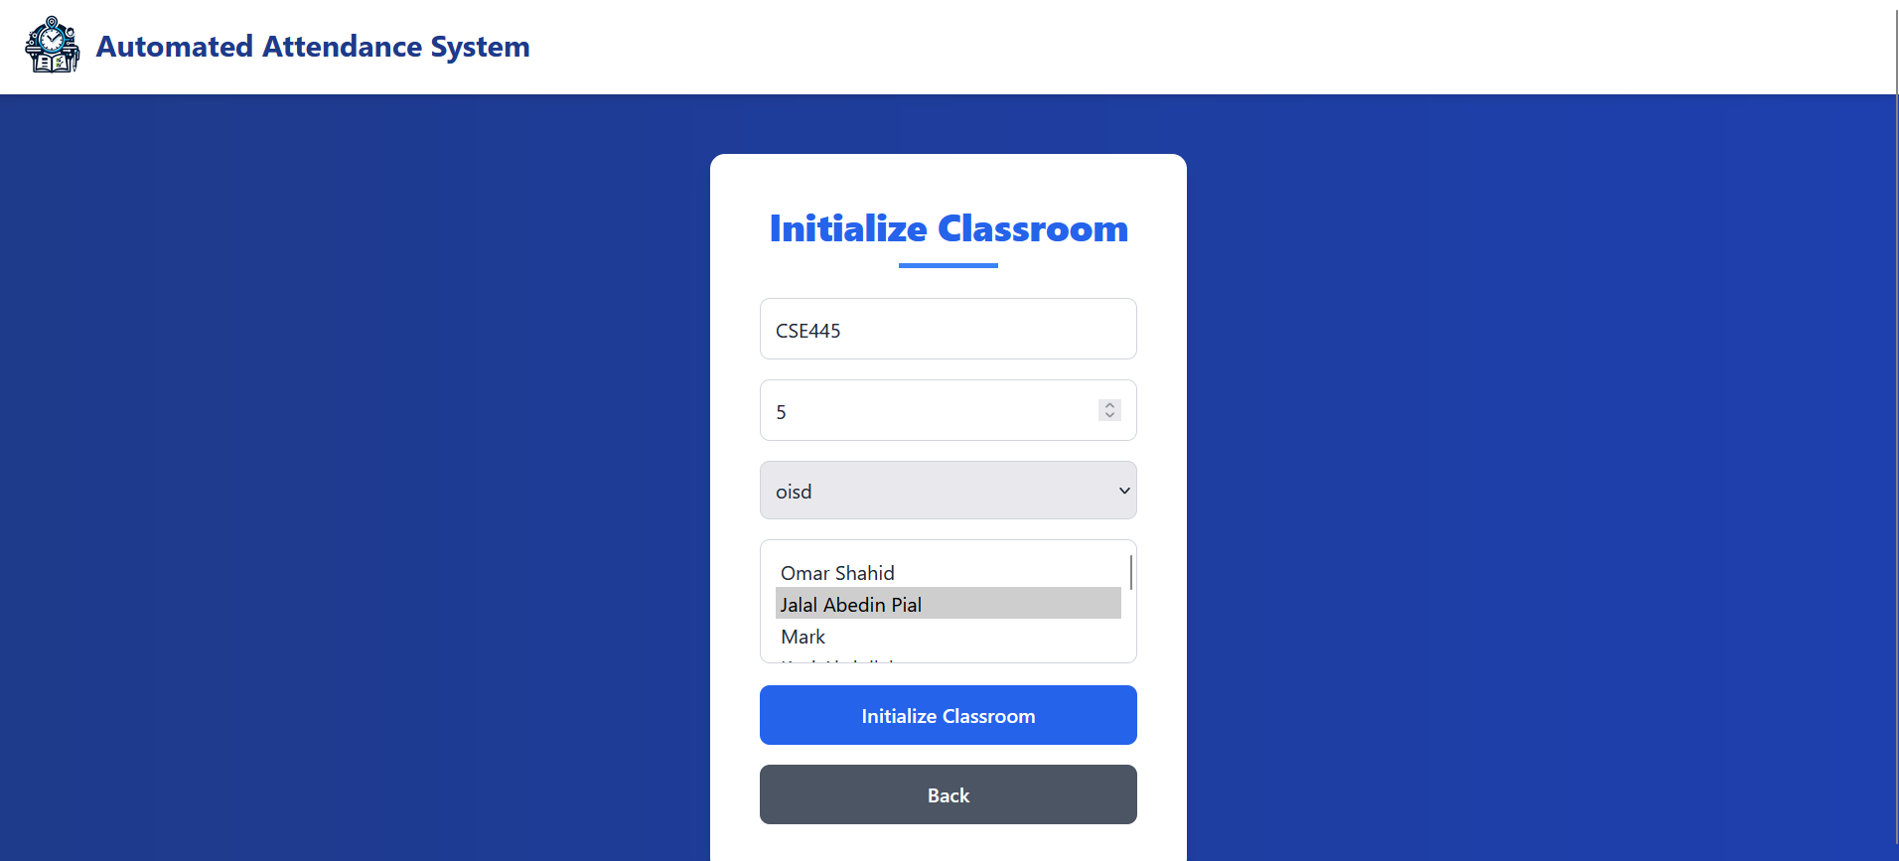
Classroom Initializer

Slide 21
Issues faced:
01
04
What previledges should admin and faculties have over database?
Required Data fields?
What is datatype that we need?
02
Issues
05
Redundant Data
How to store connect php and python?
03
06
Storing Attendance

Slide 22
Next Plans:
01
Debugging
Look for false results and bugs
Next Plans:
02
New Small Functionalities
Student Dashboard, Module sharing etc

Slide 23
Thank You!

